Slide 1
Azure Blob Storage
Blob storage to store images such as profile picture.
Video Content
00:00 – Creation of Azure Blob Storage in Azure Portal
01:47 – Connecting system to Blob Storage

Slide 2
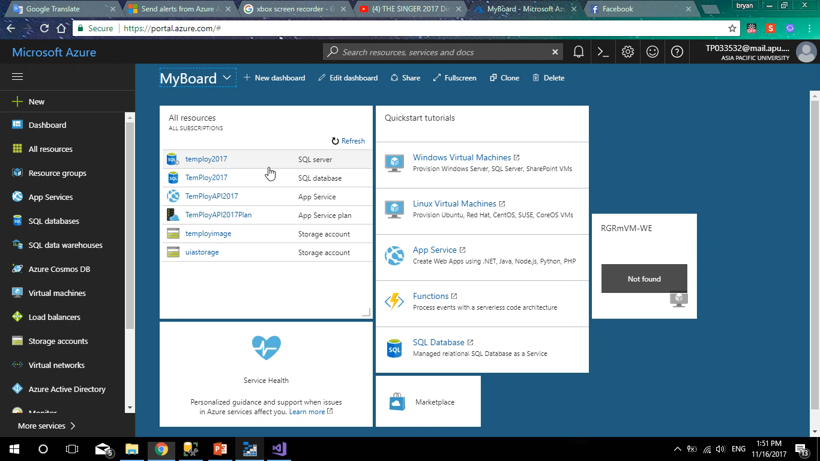

Slide 3
Azure Storage Management Tool
Microsoft Azure Storage Explorer
Used to manage Blob Storage locally in user’s machine rather than at Azure portal
Video Content
00:00 – Login to Azure using Storage Explorer
00:50 – Exploring how to view the file in the storage

Slide 4
